Slide 1



MMAI 500 - Group 11
TORONTO POLICE PATROL PROGRAM
Presented by:
Annuj Kamalesan 217044322​
Parth Malviya 220895736​
Pratiksha 220137626​
Rupali Wadhawan 220189445​
Sadia Ashraf Charoo 220154704​
Sreekanth Potlabathini 220088993​
“The work we submitted as part of this assignment is original, and due credit is given to others where appropriate. We accept and acknowledge that each member of our team is equally responsible if the assignment is found to be plagiarized in any way, and we will be subject to the school’s Academic Integrity policy”
July 2023

Slide 2
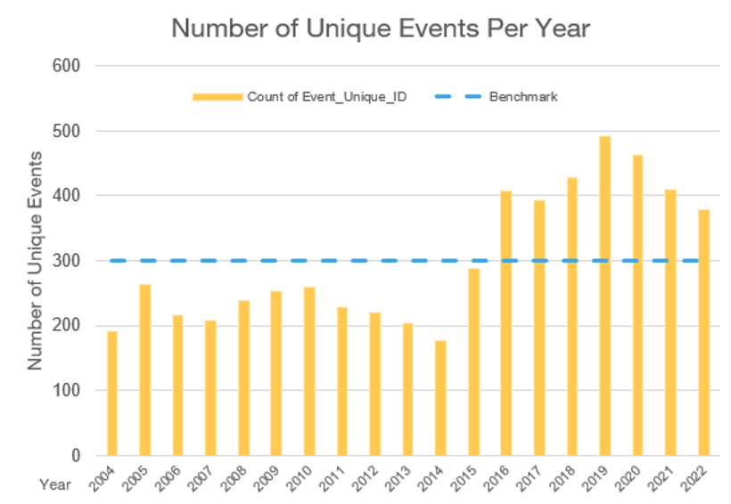
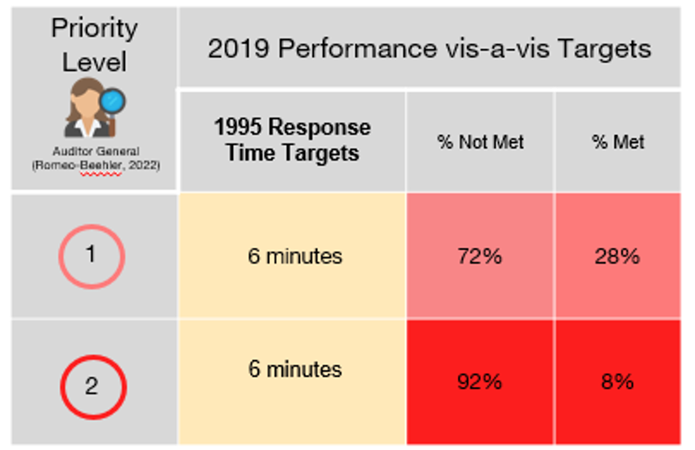




BACKGROUND
High Frequency of Crimes in the past 6 years
A trend has developed, with around 300 instances per year serving as a worrisome baseline. The TPS needs assistance to stop these injuries and fatalities.
The performance targets set in 1995 aim for a response time of 6 minutes for P1 and P2 calls. Figures show that these targets were not met by 72% of P1 calls and 92% of P2 calls.
Proposed
Solution
External Environment
Descriptive Statistics
Recommendations
& Conclusion
Background
Problem
Model
Limitations
Notes:
Pratiksha

Slide 3




PROBLEM STATEMENT
Identifying current challenges
Toronto Police Services (TPS) management has noted a worrying pattern of more than 300 shooting events per year in the past 6 years.
The Toronto Police Services management seeks to enhance their understanding of response timings to effectively reduce shooting incidents, deaths, and injuries.
Proposed
Solution
External Environment
Descriptive Statistics
Recommendations
& Conclusion
Background
Problem
Model
Limitations
Notes:
Pratiksha: A thorough solution is required to address these issues because the 1995 response time targets are out-of-date and continue to go unmet inside the department.

Slide 4





Predictive model via a Heatmap
PROPOSED SOLUTION
An innovative approach to prevent crime
Using AI predictive modelling, identify high risk areas through a heatmap and recommend optimized patrol schedules to ensure minimal response time.
This comprehensive strategy aims to provide the TPS management with data-driven insights and effective crime reduction tactics for the benefit of the divisions.
Create insights for divisions
Analyze the data to create new divisional response time guidelines based on historical data.
Continuous support to help the external environment
Integrate with internal TPS tools such as ArcGIS, TRMS and provide training, documentation and support to TPS management and PRU constables.
Proposed
Solution
External Environment
Descriptive Statistics
Recommendations
& Conclusion
Background
Problem
Model
Limitations
Notes:
Soha

Slide 5





EXTERNAL ENVIRONMENT ANALYSIS
REGULATORY
CONSIDERATIONS
TECHNOLOGY CONSIDERATIONS
Our Solution is Medium Risk
Our Solution must meet constraints
Categorized as a Medium-risk technology in the TPSB's new AI policy due to worries about privacy and potential biases towards communities. Our solution will monitor for privacy and discrimination issues, assuring an ethical and responsible implementation.
While developing the new reaction time criteria, our solution must carefully consider the number of police officers each division and abide by the 70% reactive service constraint.
Our solution can help beyond response time
Our Solution needs to integrate with the TPS
By automating response time creation based on location data, enhancing at-scene compliance, and facilitating effective communication with the TPS software, our suggested solution will address this problem.
Our solution will include comprehensive instructions and training materials to assist the TPS in using the tool efficiently and maximizing its potential impact.
Proposed
Solution
External Environment
Descriptive Statistics
Recommendations
& Conclusion
Background
Problem
Model
Limitations
Notes:
Soha

Slide 6
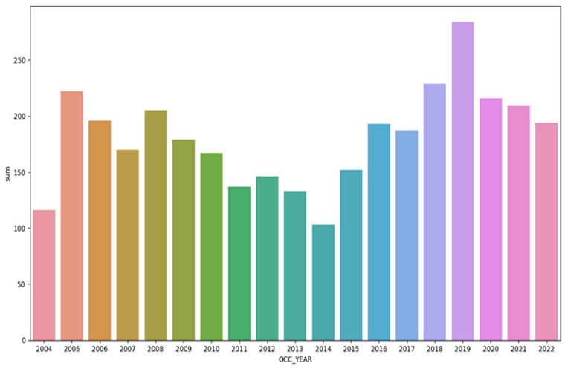
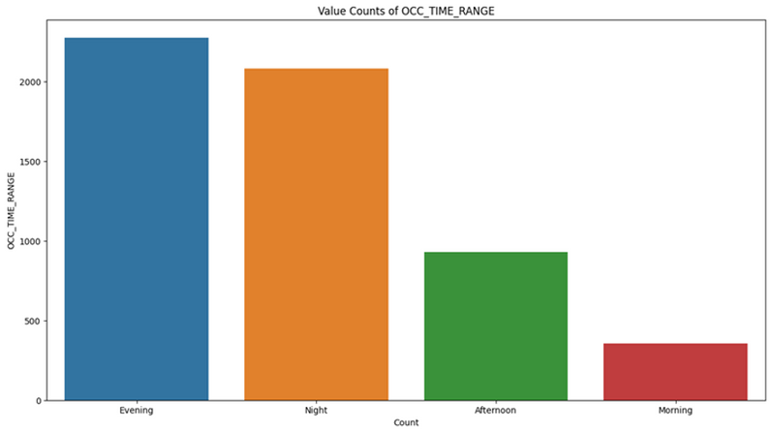
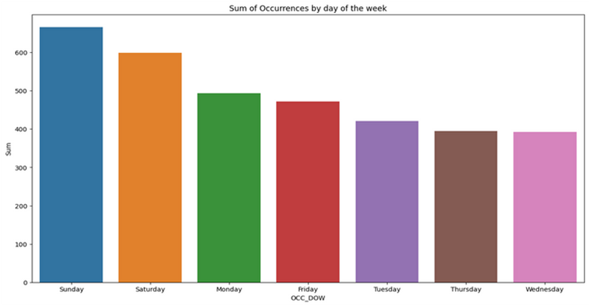
DESCRIPTIVE STATISTICS
Patterns and Trends
Year Vs. Deaths Reported
Time of Day Vs. Incidents reported
Day of the week Vs. Incidents reported
2019 had the highest deaths (492)
Highest observation during evening hours
Sunday and Saturday have the highest occurrences
Proposed
Solution
External Environment
Descriptive Statistics
Recommendations
& Conclusion
Background
Problem
Model
Limitations
Notes:
Descriptive statistics is important to understand patterns in the data and how best we can use them for analysis.
Like we could see that 2019 had the highest number of deaths observed mostly during evenings over the weekend.

Slide 7
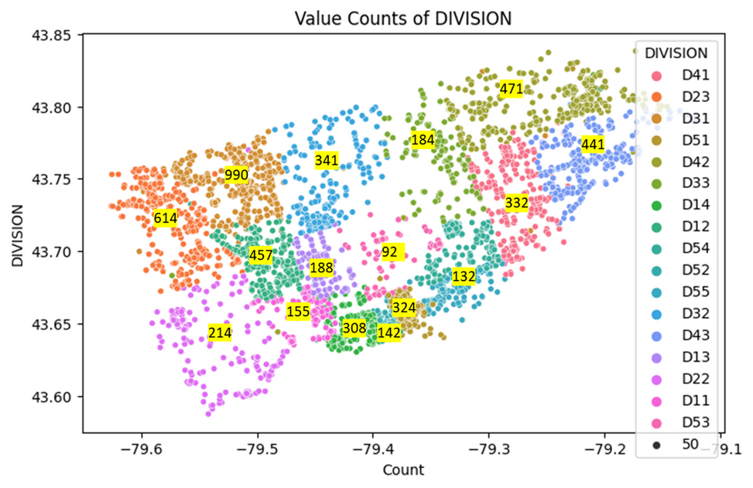
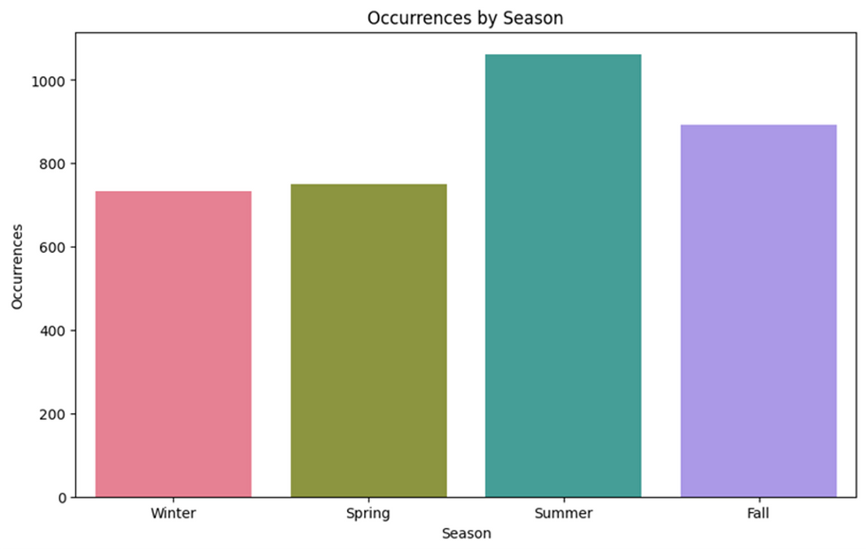

DESCRIPTIVE STATISTICS
Patterns and Trends
Injuries count across divisions
Incidents across season
For D31 and D23 count across to 500
Summers show the highest occurrences
Proposed
Solution
External Environment
Descriptive Statistics
Recommendations
& Conclusion
Background
Problem
Model
Limitations
Notes:
To align with our goal to reduce response time we segmented based on police division to find D31 & 23 having higher than 500 reporting and summer having the most occurrence.

Slide 8




MODEL SELECTION
Why did we choose Gradient Boosting Regression?
Dealing with complex relationships
Efficiency for expansion
This model helps with making use of both temporal and spatial features to establish accurate predictions regarding occurrences. Our model has numerical features like longitude and latitude along with the categorical variables. Gradient Boosting is an efficient method for addressing this variety of feature types during the training phase, ensuring that precise predictions are being produced.
The model can handle big datasets so if this model were to be expanded beyond shootings to include other crimes it would still produce accurate results.
Outlier Robustness
The efficiency of gradient boosting to handle outliers ensures that extreme data points do not significantly affect the model's predictions. This improves the model's stability and dependability.
Proposed
Solution
External Environment
Descriptive Statistics
Recommendations
& Conclusion
Background
Problem
Model
Limitations
Notes:
Parth

Slide 9



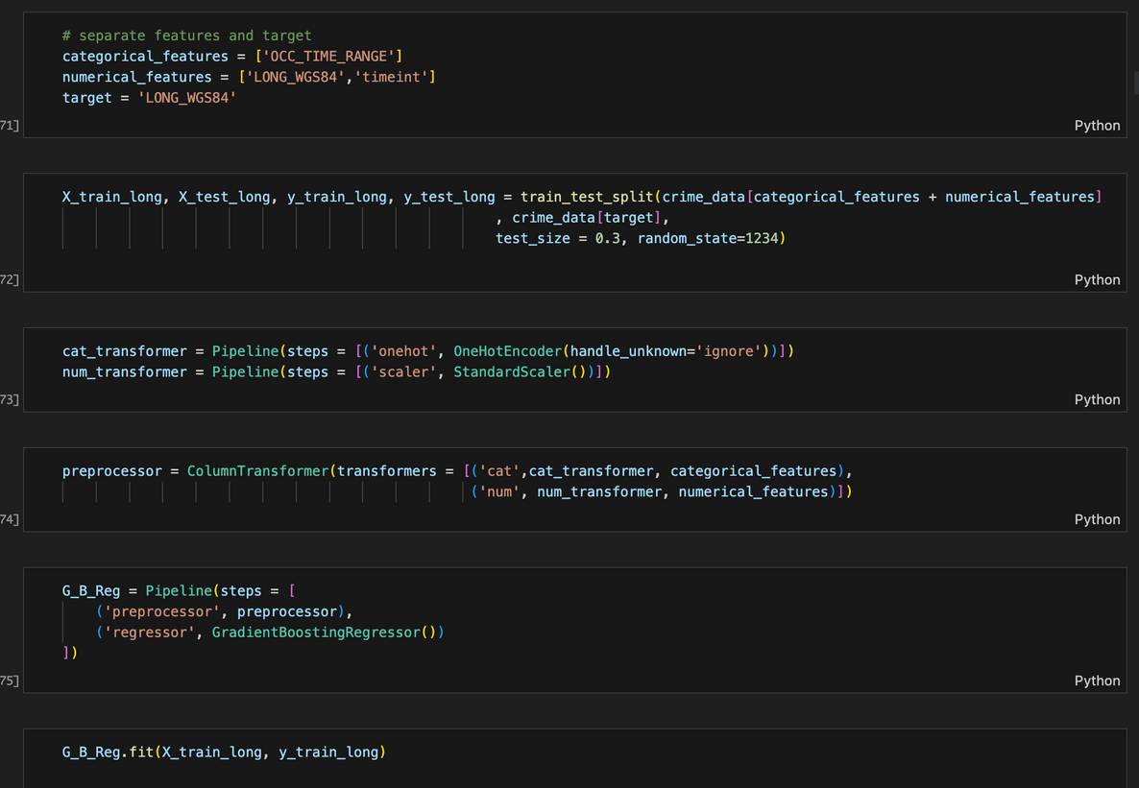
HOW DOES THE MODEL WORK?
Model explanation
The three fundamental components of the model—
2 numerical features: longitude/latitude and timeint
1 categorical feature: OCC_TIME_RANGE
Split the data into train (70%) and test data
Transformations such as one-hot encoding for categorical variables and standard scaling for numerical variables
We put all preprocessing steps into a pipeline with the regressor

Slide 10
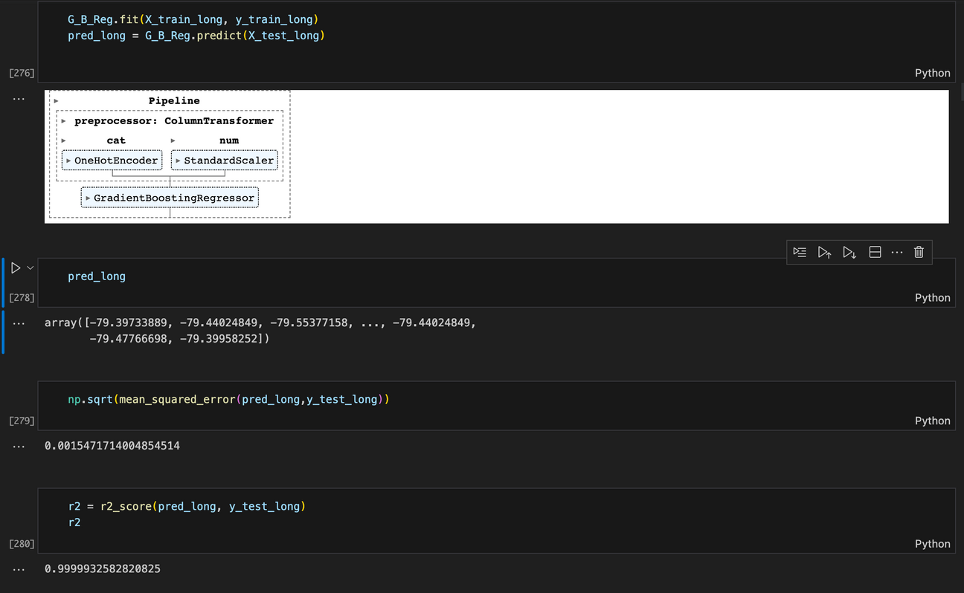
HOW DOES THE MODEL WORK?
Model explanation
We fit the model with train data
and predicted values for longitude based on test data
We checked the accuracy based on some metrics such as RMSE and R2 score.
We did this entire process for Latitude as well.

Slide 11
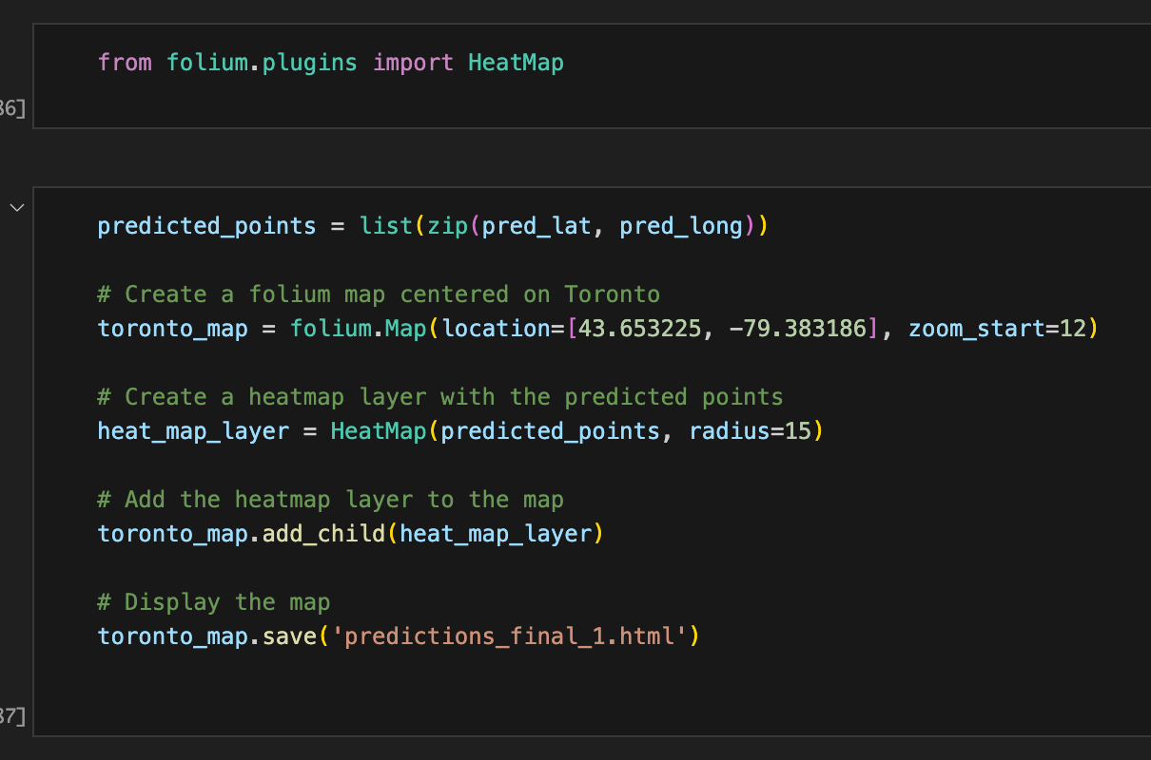
HOW DOES THE MODEL WORK?
Model explanation
The folium package is then used to create a heat map in order to spatially visualize the forecasts. The volume map, which is centred on Toronto, is enhanced with a heat map layer to more clearly indicate the expected spots.
Response time was calculated by calculating the driving distance between each division’s coordinates and the nearest police station coordinates and dividing it by a constant assumed speed of 70 km/h.
Notes:
the distance was divided by a constant assumed speed of 70 km/h to come up with a Response Time for each division. To calculate the driving distance, we used the Google Distance Matrix API

Slide 12

END-PRODUCT UI/UX WITH HEAT MAP
The product we have created with the integrated heatmap
SEE MOCKUP IN GITHUB README

Slide 13





Predicted Latitude:
RMSE - 0.0007663717814922817
R2 score - 0.9999999667946561
MODEL EXPLANATION AND EVALUATION
How did we evaluate our model?
159
17
Back- end classification: Neighbourhoods
Front- end classification: Divisional Police stations
Model evaluation Metrics
Predicted Longitude:
RMSE - 0.0015471714004854514
R2 score - 0.9999932582820825
The dataset has 159 neighbourhoods that we have colour-coded to represent the level of hazard as follows:
We marked the police stations on the heat map with black markers. Using these locations, we were able to calculate response time for each neighbourhood.
Low danger neighbourhood
Predicted Latitude:
RMSE - 0.0007663717814922817
R2 score - 0.9999999667946561
Medium danger neighbourhood
High danger neighbourhood
Proposed
Solution
External Environment
Descriptive Statistics
Recommendations
& Conclusion
Background
Problem
Model
Limitations
Notes:
Annuj: According to our system, neighbourhoods were divided into three categories: high danger, medium danger, and low danger. High danger neighbourhoods were those with more than 15 crimes, medium danger neighbourhoods had more than seven crimes but fewer than 15, and low danger neighbourhoods had fewer than seven crimes. Our danger variable, which helps identify regions to focus on for crime prevention and response tactics, is built on the classification that serves as its basis

Slide 14
MODEL LIMITATIONS
What are the limitations affecting this model?
Late Reporting
Budget restraints & resource prioritization
Police cars are unable to record when they have responded due to high stress situations
The solution must be adaptable in recommending patrol coverage levels considering financial constraints
Dynamic Police Car Movements
Speed
of the car
Although our model assumes police cars are static an ideal model with the right resources could predict ideal patrol schedules across time intervals.
We assumed a speed of 70 km/h per police car. This number not being dynamic, tied to weather, traffic time, or season impacts the realism of our model.
Multiple incidents & Resource Allocation
Server = Dynamic
Shootings Incidences are not the only call priority response units take in account. Our team would love to expand with a larger dataset.
All the dynamic elements of a full schedule & updating danger variable would be possible if the team had access to a back-end server such as Flask.
Proposed
Solution
External Environment
Descriptive Statistics
Recommendations
& Conclusion
Background
Problem
Model
Limitations
Notes:
Annuj

Slide 15
Division | Our Response Time | TPS Response Time
D11 | 5.023386 | 17.9
D12 | 5.029443 | 17.9
D13 | 5.046171 | 17.1
D14 | 5.039071 | 18.7
D22 | 15.006371 | 18.3
D23 | 6.080014 | 20.4
D31 | 5.025843 | 20.1
D32 | 5.020743 | 22.3
D33 | 5.010271 | 20.9
D41 | 5.058000 | 16.6
D42 | 5.006343 | 23.9
D43 | 5.074800 | 17.4
D51 | 5.010614 | 19
D52 | 5.001600 | 20.6
D53 | 5.016029 | 23.9
D54 | 5.017243 | 14.9
D55 | 5.054371 | 15.3
RECOMMENDATIONS &
CONCLUSION
Our key recommendations align with the three primary objectives we pursued during this project.
To create an AI heat map to optimize the placement of police cars based on the danger variable. Through our analysis, we have successfully identified optimal locations for placing police cars in each neighborhood as shown in our UI.
01.
02.
To create a new updated response time guideline given the resource constraints for each division.
03.
To integrate our solution with internal reporting and live reporting tools.
our recommendations encompass the deployment of the AI heat map for optimized police car placement, the implementation of updated response time guidelines, and a collaborative approach to integrating our solution with existing TPS systems.
Proposed
Solution
External Environment
Descriptive Statistics
Recommendations
& Conclusion
Background
Problem
Model
Limitations
Notes:
Parth: We were unable to access the required software as it is either proprietary or requires a paid license. If the TPS likes the model we propose they spend some capital to help with integration.

Slide 16
CITATIONS
1. ArcGIS online. arcgis.com. (n.d.). By creating a class system that is cheap but has useful learning, is an ideal solution for users
City of Toronto. (n.d.).By creating a class system that is cheap but has useful learning, is an ideal solution for users
2. “Artificial Intelligence Procedure Consultation.” Artificial Intelligence Procedure Consultation- Toronto Police Service,www.tps.ca/police-reform/artificial-intelligence-procedure-consultation/. Accessed 5 June 2023.
3.“Data Analytics.” Toronto Police Service Public Safety Data Portal, data.torontopolice.on.ca/pages/data-
analytics. Accessed 5 June 2023.
4. “Free Icons and Stickers - Millions of Images to Download.” Flaticon, www.flaticon.com/. Accessed 5 June 2023.
5. “Intergraph Computer-Aided Dispatch (I/CAD).” Hexagon, hexagon.com/products/intergraph-computer-aided-dispatch. Accessed 5 June 2023.
6. scikit. (2023). Gradient boosting regression. scikitlearn.By creating a class system that is cheap but has useful learning, is an ideal solution for users
7. Romeo-Beehler. “Review of Toronto Police Service – Opportunities to Support More Effective Responses to Calls for Service.” Toronto Auditor General, 14 June 2022, www.torontoauditor.ca/report/review-of-toronto-police-service-opportunities-to-support-more-effective-responses-to-calls-for-service/.
8. Romeo-Beehler, www.toronto.ca/legdocs/mmis/2022/au/bgrd/backgroundfile-228234.pdf, 14 June 2022, Accessed 5 June 2023.
9. “Shooting and Firearm Discharges Open Data.” Toronto Police Service Public Safety Data Portal, data.torontopolice.on.ca/datasets/TorontoPS::shooting-and-firearm-discharges-open-data/explore?location=43.696050%2C-79.363765%2C10.00. Accessed 5 June 2023.
10. SWOT Analysis of the Metropolitan Police Department Example.” Free Essays - PhDessay.Com, 17 Aug. 2022, phdessay.com/swot-analysis-of-the-metropolitan-police-department/
11. “Use of Artificial Intelligence Technology.” Toronto Police Services Board, 19 May 2022, tpsb.ca/policies-by-laws/board-policies/195-use-of-artificial-intelligence-technology.
12. “Use of New Artificial Intelligence Technology Policy - Public Consultation.” Toronto Police Services Board - Artificial Intelligence Technologies Policy - Public Consultation, 5 Aug. 2022, tpsb.ca/ai.
13. Chen, & Guestrin, C. (2016). XGBoost: A Scalable Tree Boosting System. Proceedings of the 22nd ACM SIGKDD International Conference on Knowledge Discovery and Data Mining, 13-17-, 785–794. By creating a class system that is cheap but has useful learning, is an ideal solution for users
14. Friedman. (2001). Greedy Function Approximation: A Gradient Boosting Machine. The Annals of Statistics, 29(5), 1189–1232. By creating a class system that is cheap but has useful learning, is an ideal solution for users
15. Keefe, W. (2023, June 9). Crime location analysis and prediction using Python and Machine Learning. Medium.By creating a class system that is cheap but has useful learning, is an ideal solution for users
16. Masui, T. (2022, February 12). All you need to know about gradient boosting algorithm − Part 1. regression. Medium.By creating a class system that is cheap but has useful learning, is an ideal solution for users

Slide 17
APPENDIX
The code bundle
Google Distance Matrix API - https://console.cloud.google.com/apis/library/distance-matrix-backend.googleapis.com?project=infra-hulling-394023&supportedpurview=project
Request URL: https://maps.googleapis.com/maps/api/distancematrix/json?units=metric
HTTP Method: GET
See Code Bundle “Toronto Police Patrol Program 2.zip” attached.

